Slide 1


PHOTOGRAPH SKETCHIFICATION
USING PYTHON

Slide 2
Contents
Certificate
Introduction
Methodology
JUPYTER Notebook
Python libraries
Challenges
Solutions
Applications
Conclusion
References

Slide 3
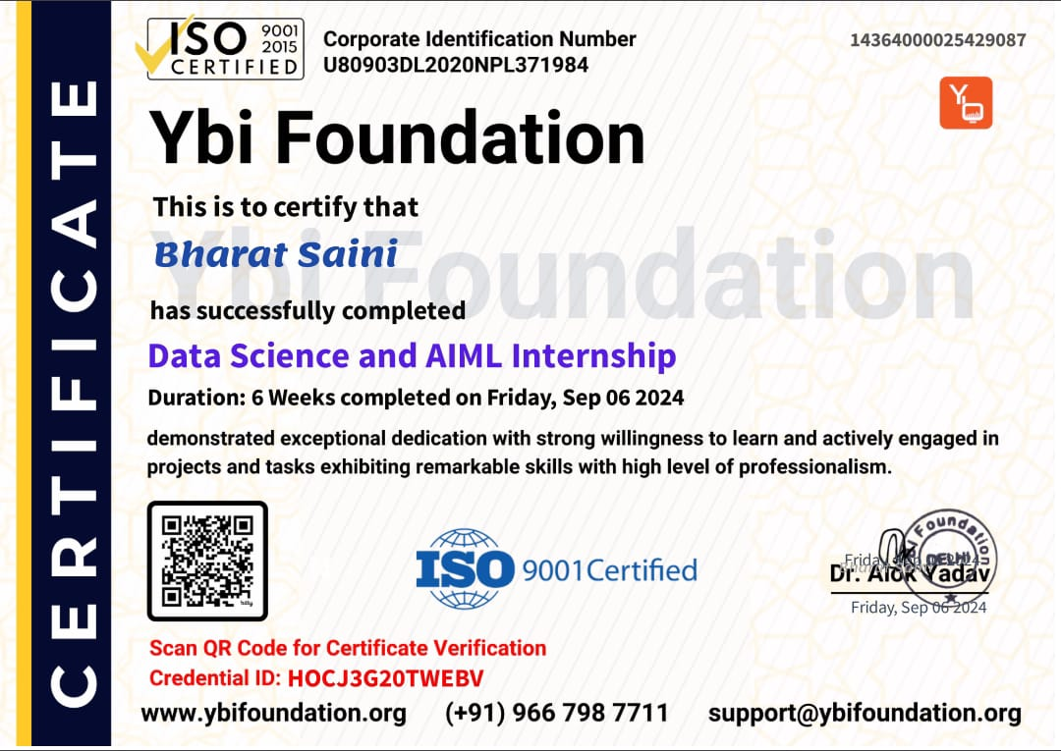


Slide 4
REGARDING YBI FOUNDATION :
YBI Foundation is a section 8 non-profit organization. They work in the field of gender equality, specially-abled people, and demographically and financially backward sectors.
YBI foundation is a platform for providing internship, skills, training and courses in emerging technologies to students with an opportunity to grow. They help students to Learn Practice Upskill and Get Job Ready with scientifically designed content by industry experts.

Slide 5
INTRODUCTION
This "Color Image to Sketch" project involves transforming a color image into a sketch-like representation using image processing techniques. This typically involves converting the original image to grayscale, detecting edges, and applying various filters or algorithms to simulate a hand-drawn effect. The goal is to retain key details and textures while giving the image a stylized, artistic appearance, often with a pencil or charcoal look. Such projects can use tools like OpenCV, machine learning models, or even AI-powered applications for automatic conversion.

Slide 6
INTRODUCTION
OBJECTIVE
The main goal of this project is to create an automated method for transforming real-world color images into monochrome sketches, while preserving the key details and contours of the original image. It allows for a seamless and visually appealing conversion that can be used for artistic, design, or practical purposes
This has applications in art, design, and photography, and can be implemented using tools like OpenCV in Python
✩
✩

Slide 7
KEY CONCEPTS
Image Processing: The process of manipulating an image to achieve a desired outcome (in this case, a sketch). This typically includes converting the image into grayscale, detecting edges, and adding artistic effects
2.Edge Detection: A critical technique used to detect boundaries in the image that are important for the sketch effect. Common algorithms include Canny Edge Detection and Sobel filters.
3.Blurring and Detail Enhancement: Blurring (often with techniques like Gaussian Blur) is used to soften the image to mimic the effect of pencil strokes. This is combined with detail enhancement techniques to ensure the sketch retains the features of the original image.

Slide 8
METHODOLOGY
CAN BE DIVIDED INTO FOLLOWING STEPS:-
Input Image: Begin with a color image in formats like JPEG, PNG, etc.
Grayscale Conversion: Convert the image to grayscale to remove color and focus on lightness and structure.
Edge Detection: Apply edge detection techniques to identify prominent features in the image.
Image Blending: Blend the detected edges with a blurred version of the original image to create a pencil sketch effect.
Fine-tuning: Adjust parameters (like contrast, brightness, or line thickness) to enhance the final sketch effect.

Slide 9
TOOLS AND TECHNOLOGIES
Programming Languages: Python (with libraries like OpenCV, NumPy, and PIL) is commonly used for such image processing tasks.
Libraries:-
OpenCV: A powerful library for computer vision and image processing.
PIL/Pillow: For image manipulation.
Matplotlib: For displaying processed images.

Slide 10

JUPYTER NOTEBOOK
Jupyter Notebook is an open-source interactive environment that combines code, visualizations, and narrative text.
It provides an interactive, web-based interface that facilitates the creation and execution of code in a cell-based structure.
Users can write and run code in individual cells, each of which can be a self-contained unit for code execution.
This modular approach promotes code organization and facilitates iterative data analysis and experimentation

Slide 11

PYTHON LIBRARIES
Python library is a collection of functions and methods that allow you to perform many actions without writing your code
The Python libraries used in this project are as follow:
CV2
NUMPY
MATPLOTLIB
IMAGEIO

Slide 12

CV2
The OpenCV (Open Source Computer Vision Library), or cv2 in Python, is a popular library for computer vision tasks. It provides numerous tools for image and video processing, such as face recognition, object detection, image transformations, and much more.
OpenCV is widely used in various fields, including robotics, machine learning, augmented reality, and artificial intelligence.
Whether you're working on computer vision, machine learning, or just experimenting with images, OpenCV is a great tool to have in your arsenal.

Slide 13
KEY FEATURS OF OPENCV(cv2) :-
Image Processing: It offers functions to read, display, and save images, as well as manipulate image pixels (e.g., scaling, rotating, cropping).
Edge Detection and Filtering: Methods like Sobel, Canny edge detection, and various smoothing and sharpening filters are available.
Feature Detection: Tools for detecting key points, corners, faces, and objects (e.g., using Harris corner detection, SIFT, SURF, or ORB).
Machine Learning Integration: It integrates with machine learning libraries for tasks like object classification, segmentation, and tracking.
Real-Time Video Processing: OpenCV can capture and process video feeds from cameras, perform video analysis, and even detect and track moving objects.

Slide 14
NUMPY
NumPy stands for Numerical python and is the core library for numeric and scientific computing.
NumPy focuses on scientific and mathematical computation.
It makes it easy to work with large matrices and multidimensional data thanks to built-in mathematical functions that make it easy to compute.
NumPy is preferred over lists in Python because it uses less memory, is faster, and is easier to use.
NumPy is required for full-stack developers to use this machine learning library.
It consist of Multidimensional array objects and a collection of routines for processing those array.

Slide 15
MATPLOTLIB
Matplotlib is a python library used for data visualization.
This library is responsible for the plotting of numerical data.
It is utilized in data analysis for this reason.
An open-source library plots superior quality figures, for example, pie outlines, scatterplots, boxplots, and diagrams, in addition to other things.
You can create bar plot ,scatter plots, histograms and a lot more with matplotlib.

Slide 16
IMAGEIO
The IMAGEIO library in Python is a powerful and user-friendly library for reading and writing image data, including support for various image formats like PNG, JPEG, TIFF, GIF
Reading and Writing Images: imageio can read and write a wide range of image formats such as PNG, JPEG, TIFF, BMP, GIF, and more. It also supports reading images from URLs or raw binary data.
Support for Animated GIFs: It allows reading and writing animated GIFs and other multi-frame images.
3D Image Support: imageio has capabilities for working with volumetric data (3D images), such as .nii files (used in medical imaging) and other formats.
Compatibility with NumPy: It integrates well with NumPy, enabling you to read images as NumPy arrays and perform efficient image manipulation and analysis.
Simple Interface: Unlike some other image libraries, imageio aims to provide a simple and intuitive interface, which is great for beginners and professionals alike.

Slide 17
CHALLENGES
Preserving Image Detail and Features
Converting a color image into a sketch often results in the loss of finer details, which could make the output less recognizable.
Blurring Artifacts
Excessive blurring can make the sketch look too vague or abstract, while insufficient blurring can make the sketch look harsh or artificial.
Handling Noise in the Image
Noise in the image (especially in uniform regions or backgrounds) can result in unwanted artifacts in the sketch.
Loss of Color Information
The process of converting to a grayscale or monochromatic sketch removes color information, which can make the sketch less visually appealing.
Real-Time Processing Performance
Processing high-resolution images or video frames in real-time for generating sketches can be slow and computationally expensive.

Slide 18
SOLUTION
1.Use edge detection (e.g., Canny, Sobel) to capture important features, and apply multi-scale Gaussian blurring to maintain structure while softening background areas.
2.Provide adaptive blurring, allowing the blur intensity to adjust based on the image content, or let users customize blur strength.
3.Apply denoising algorithms (e.g., Non-Local Means Denoising) before sketch generation to clean up noise and smooth the image.
4.Reintroduce subtle color through selective colorization or apply a sepia tone to the sketch after conversion.
5.Implement image resizing to scale down large images or use GPU acceleration for faster real-time processing, especially in video-based applications.

Slide 19
APPLICATIONS :
Digital Art and Animation: Artists and animators use sketch effects to create hand-drawn style images. Converting photographs or digital art to sketches can give a more organic, hand-crafted look for use in animations, comics, or storyboards.
Creative Filters in Apps: Popular photo editing apps or websites can incorporate a sketch filter that transforms ordinary images into artistic sketches, similar to what apps like Instagram offer for photo enhancement.
Portrait Sketching: Converting portraits into sketches is a popular application for online platforms offering personalized services, such as photo-to-sketch conversion for gifts or memorabilia.
Medical Diagnostics: Converting medical images (e.g., CT scans, MRI scans) into sketches or simplified diagrams can help doctors focus on specific areas of concern by enhancing key features such as boundaries, edges, or anomalies.

Slide 20
APPLICATIONS :
Preprocessing for Object Recognition: In some computer vision tasks, converting color images to sketches (or more generally, simplifying an image by reducing color and detail) can help highlight edges and boundaries of objects, which is useful in object detection and recognition tasks. This helps algorithms identify important contours, features, and shapes in an image more effectively.
Illustration and Diagrams: In educational contexts, converting images to sketches can simplify complex concepts for students. Diagrams, illustrations, and visual aids that explain scientific or mathematical principles can be enhanced by using sketch filters to highlight important features.
Photo Effects for Social Media: Many apps and websites offer the option to apply artistic filters to photos. Converting a photo to a sketch can be a unique visual effect that allows users to add creative, stylized looks to their images.
Restoring and Enhancing Historical Images: Converting old, damaged photographs into sketches can help restore the essential features of historical images without over-emphasizing noise or degradation.

Slide 21
CONCLUSION
The color image to sketch transformation is a fun and practical project in Python that allows you to explore and experiment with image processing techniques. Whether you're creating artistic visuals for personal projects, working on machine learning tasks, or building creative applications, this transformation has broad utility and can serve as an interesting starting point for further exploration in computer vision, image enhancement, and creative coding. Python, with its rich ecosystem of libraries, makes such tasks accessible to both beginners and professionals, making it an ideal language for experimenting with innovative image effects.

Slide 22
REFERENCES
Websites and Blogs:
Geeksforgeeks.org
Google.com
Github.com
Programming and Tools:
Jupyter.org
Python.org

Slide 23
THANK YOU

